Slide 1
FLY AWAY PROJECT
As the user run the project on the server a homepage will appear on the screen name as index.jsp

Slide 2
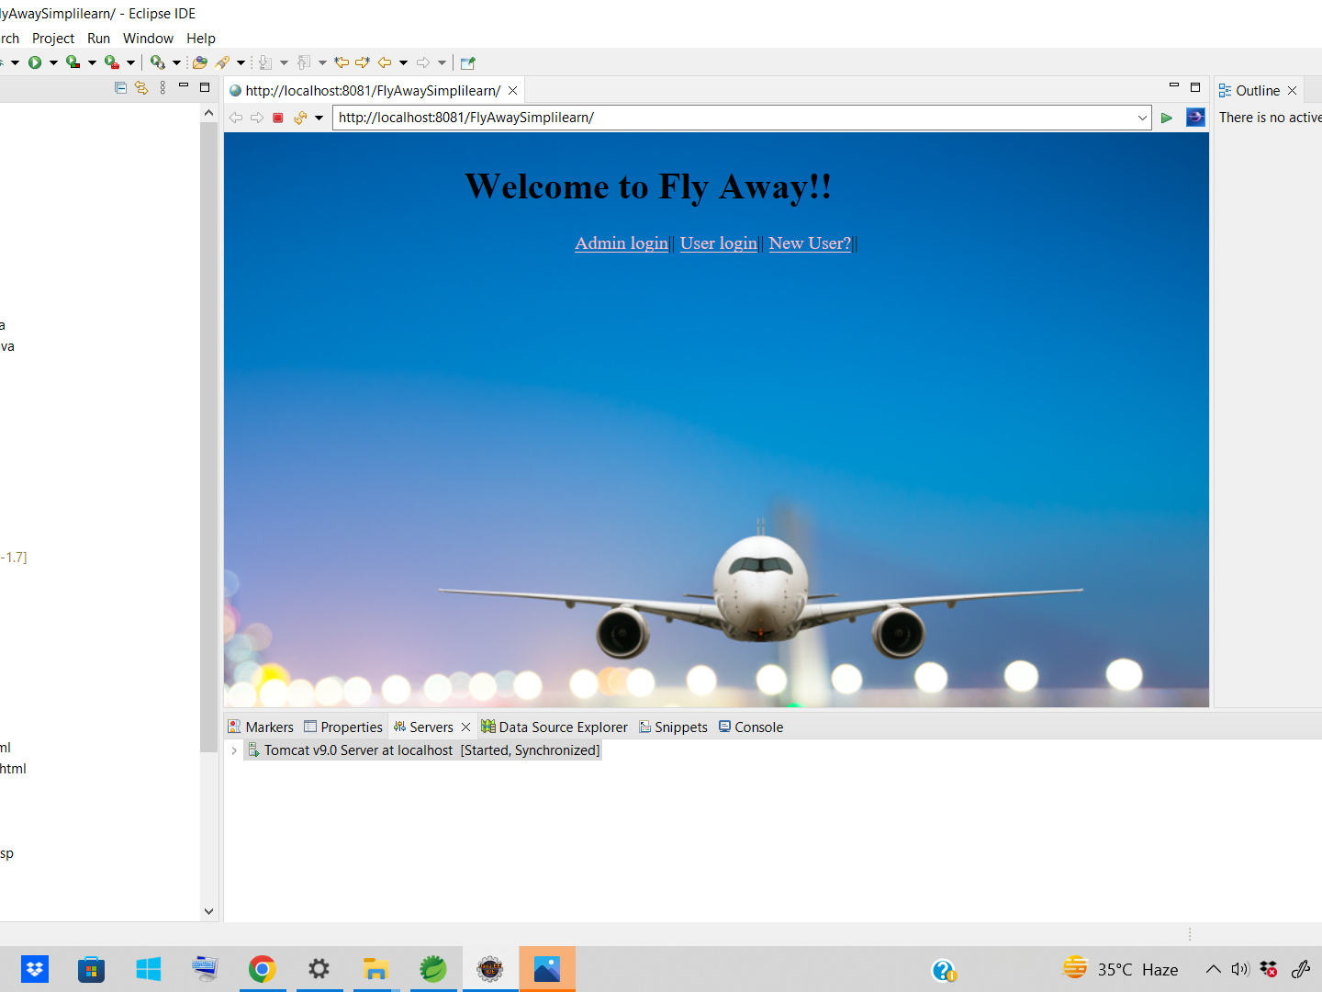
User can click different link present on the homepage. Suppose user selects admin login link for login purpose now admin login page will appear on the screen.

Slide 3
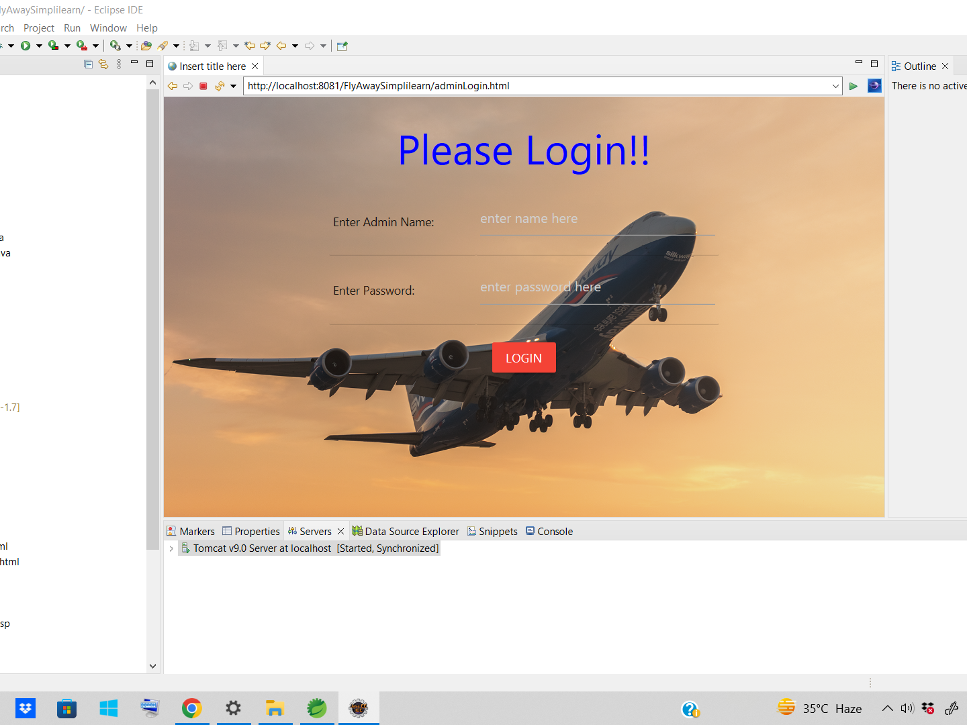
If the user enters wrong admin and password which is not present in the database table simplilearn.admin then wrong user name and password will diplay on the screen with login page.

Slide 4
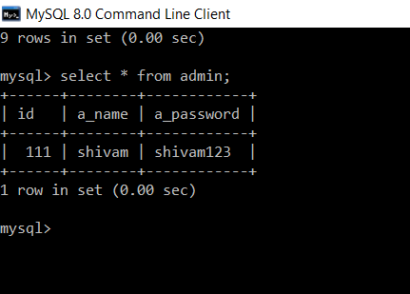
If the admin enters wrong admin name and password which is not present in the simplilearn.admin table then wrong username and password will be displayed on the screen.

Slide 5
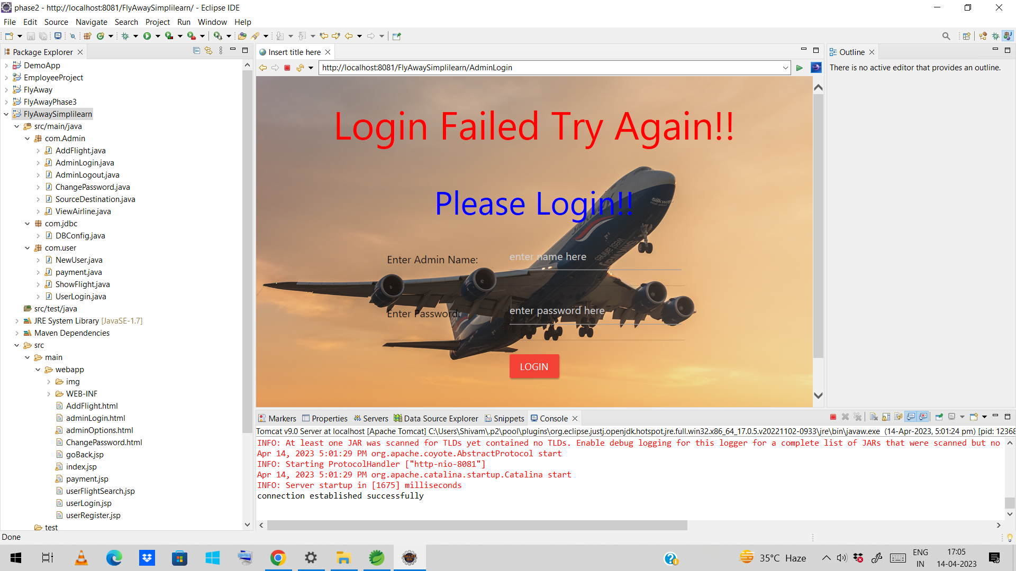
Now, admin have to re enter username and password again for login. Suppose admin enter right admin name and password then Login succesful will appear on the screen with admin name from the database.

Slide 6
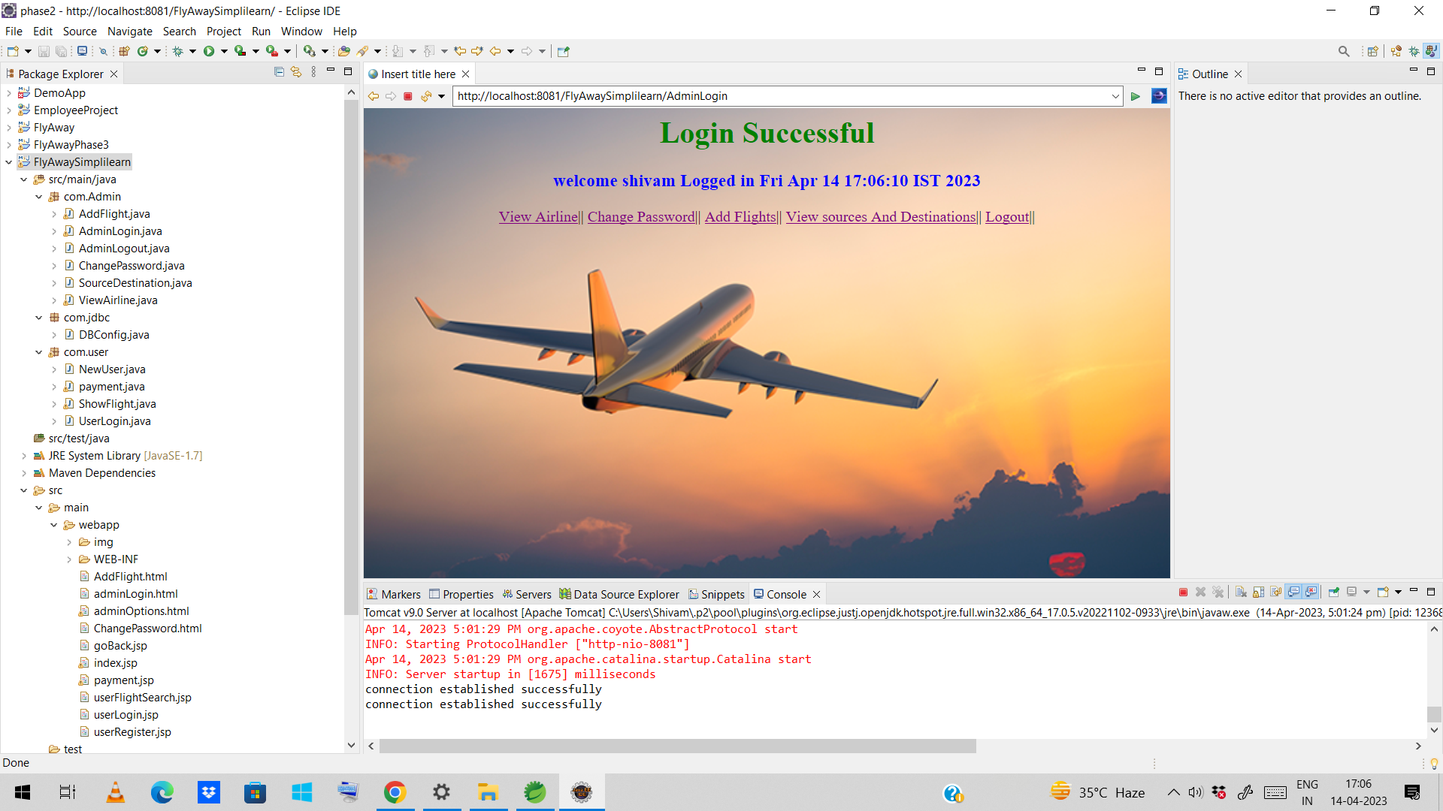
Now admin can select links after successful login. Suppose admin selects View Airline link to see available airlines on the screen.

Slide 7
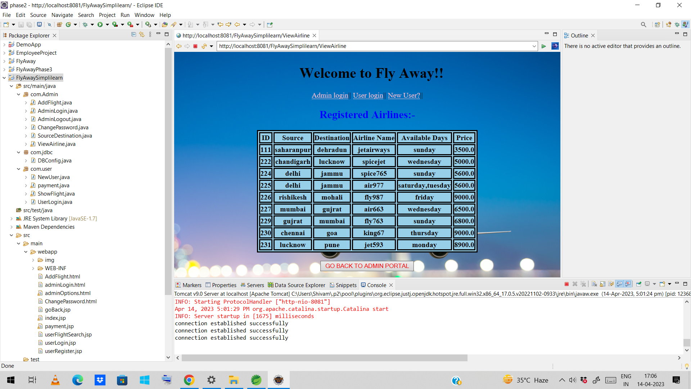
Then admin can see list of available flight from database simplilearn.airline table. User can also go back to admin portal by click on the button below.after clicking the button go back to admin portal. Admin will be back to Admin Portal.

Slide 8
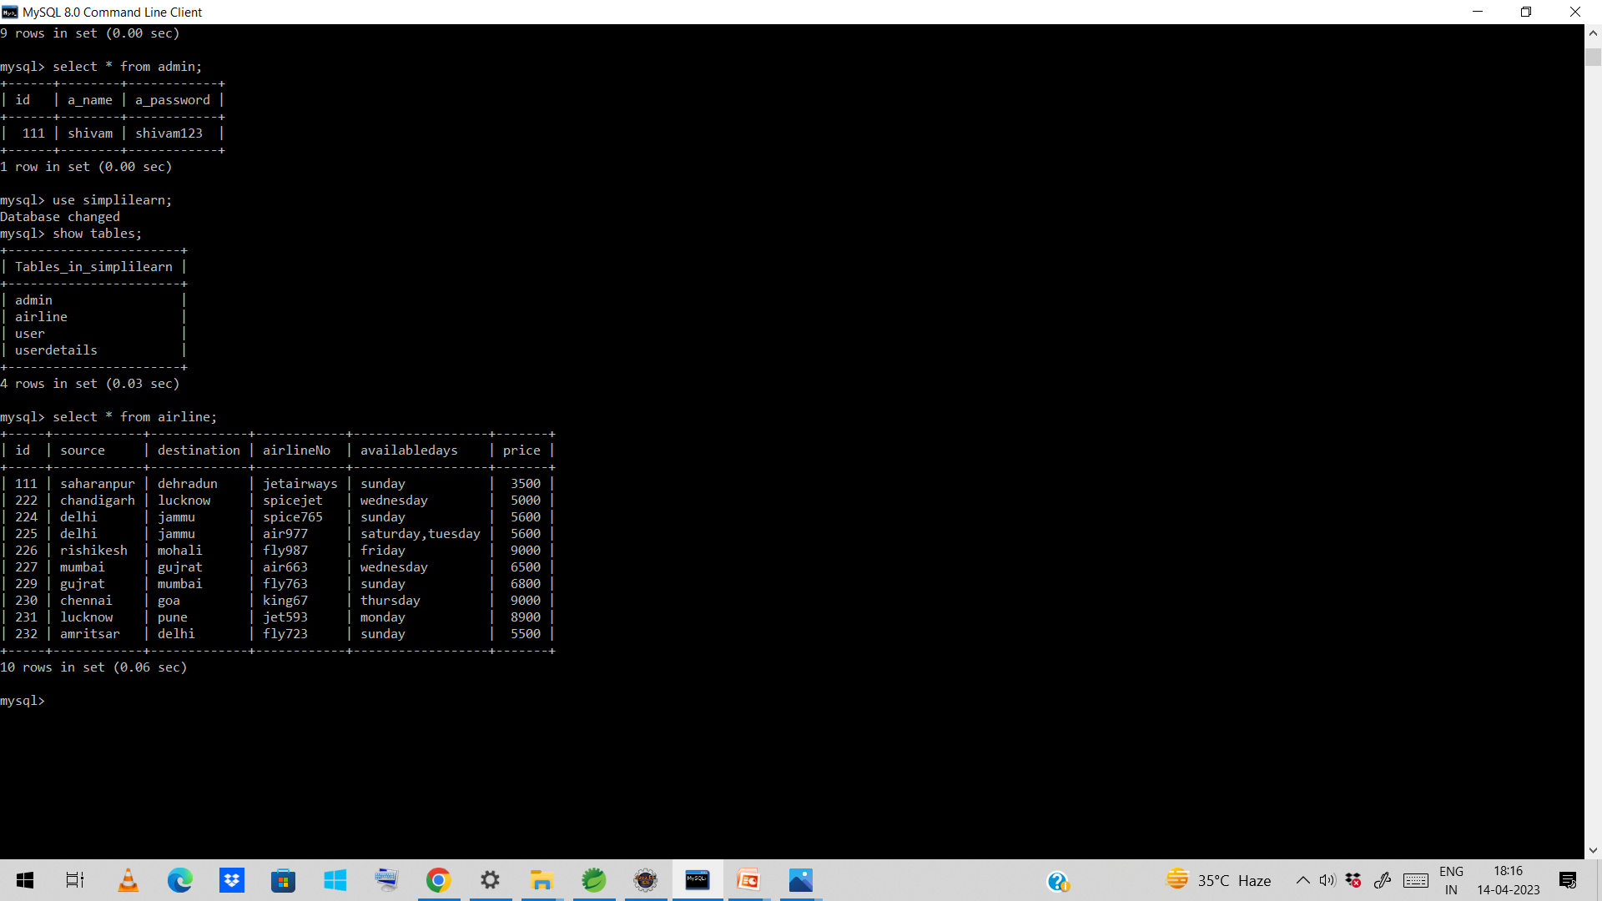

Slide 9
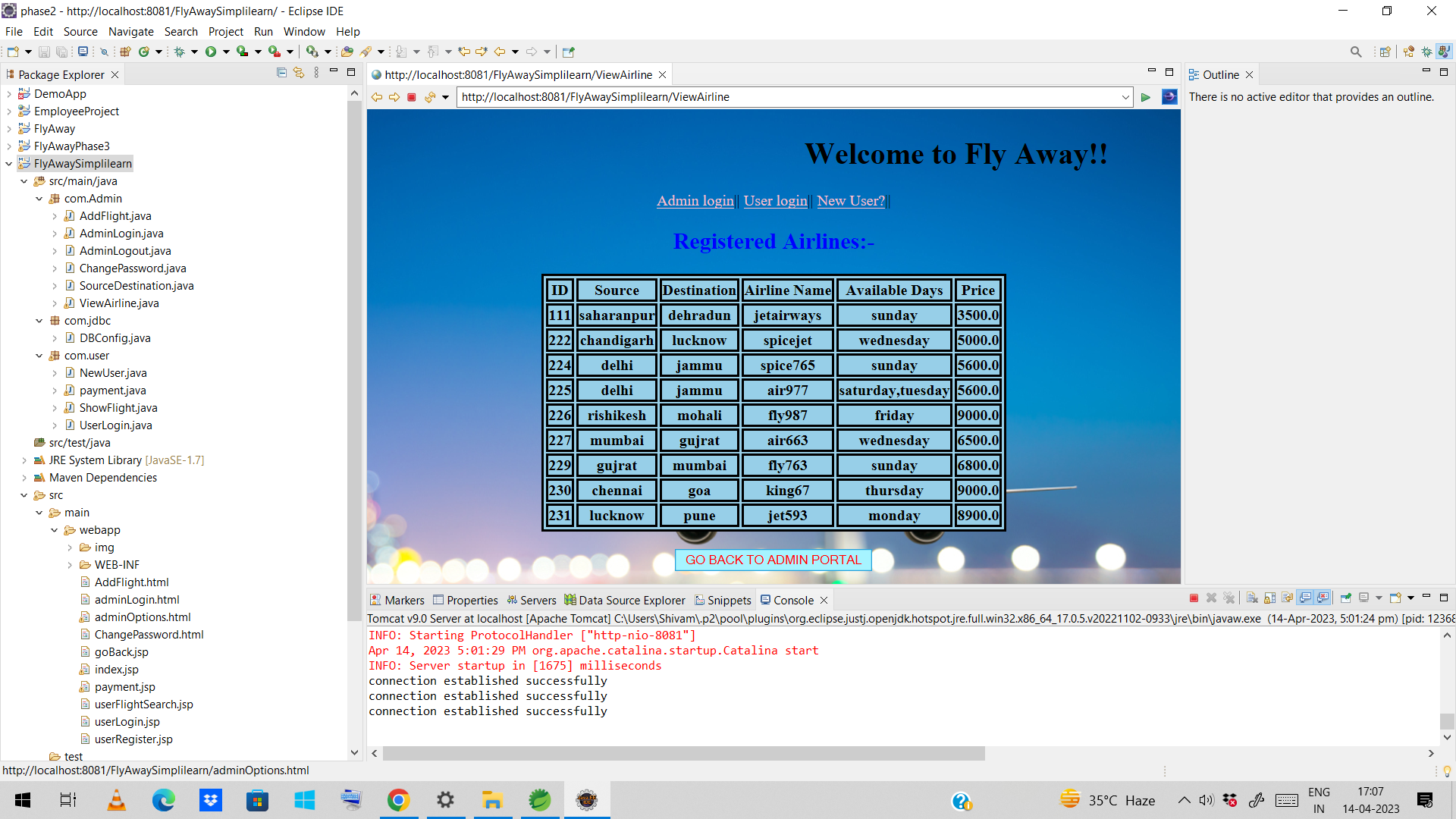

Suppose now admin selects change password link to change admin password then he will be redirected to new page where he can change password.and the password will be updated in the database simplilearn.admin table.

Slide 10
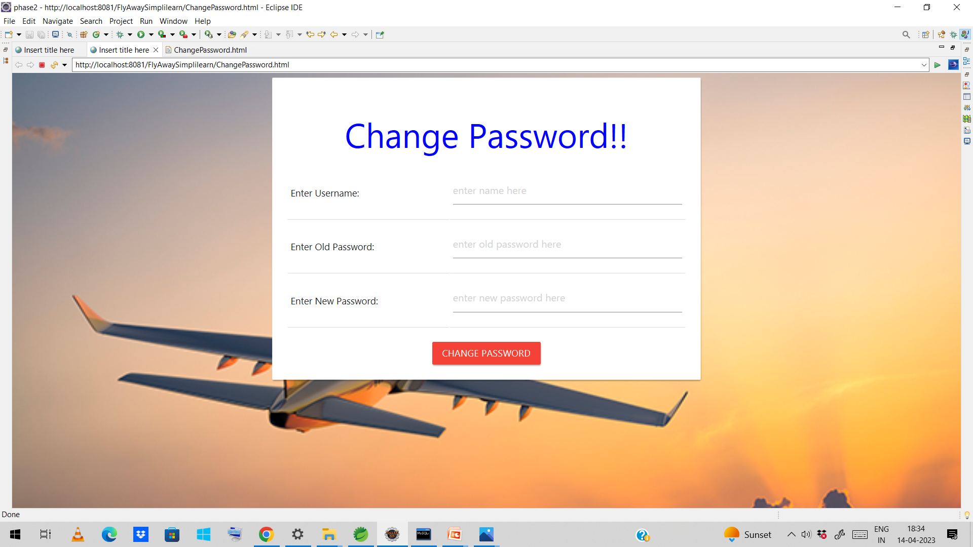
Now admin have to enter the admin, name old password and new password correctly to change the admin password and click on Change Password button and admin password will be updated in the database simplilearn.admin table

Slide 11
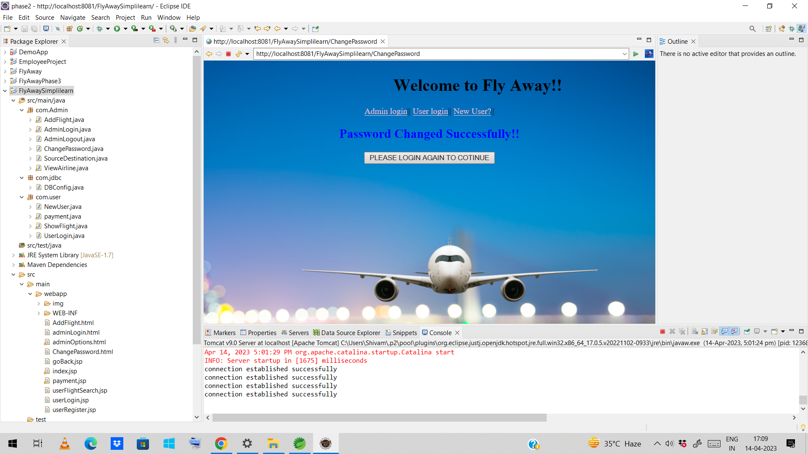
After successfully changing the password.Message will be displayed Password changed successfully. Now go back to login portal again. And login using new password.

Slide 12
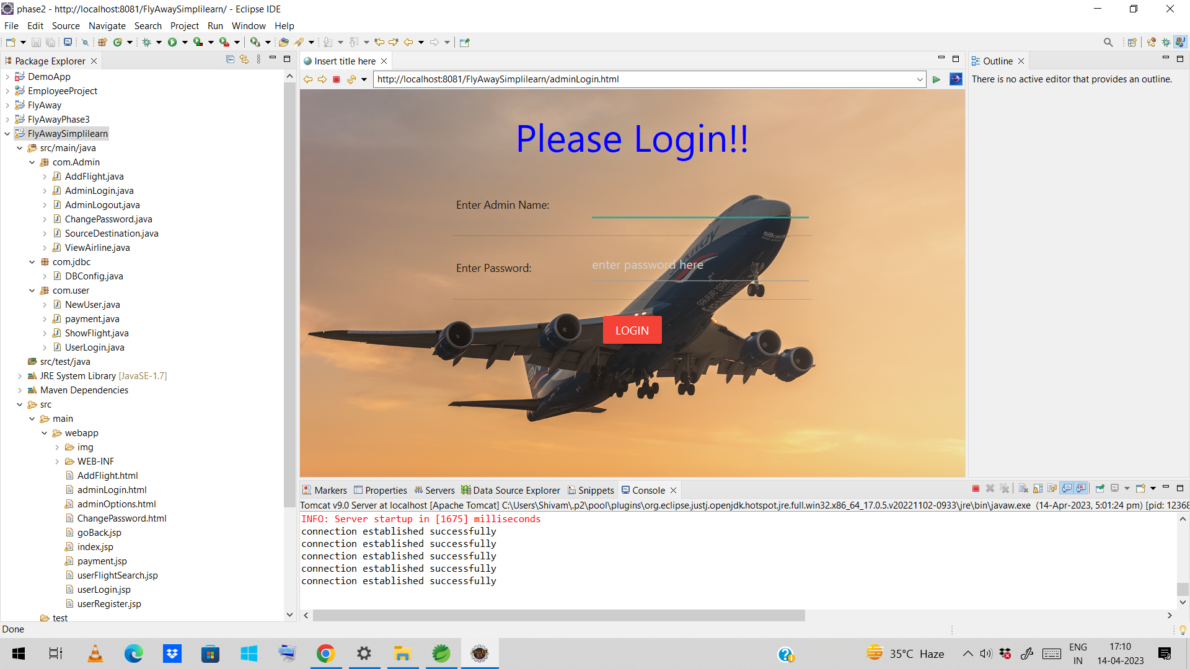
Enter Username and password again to login.

Slide 13
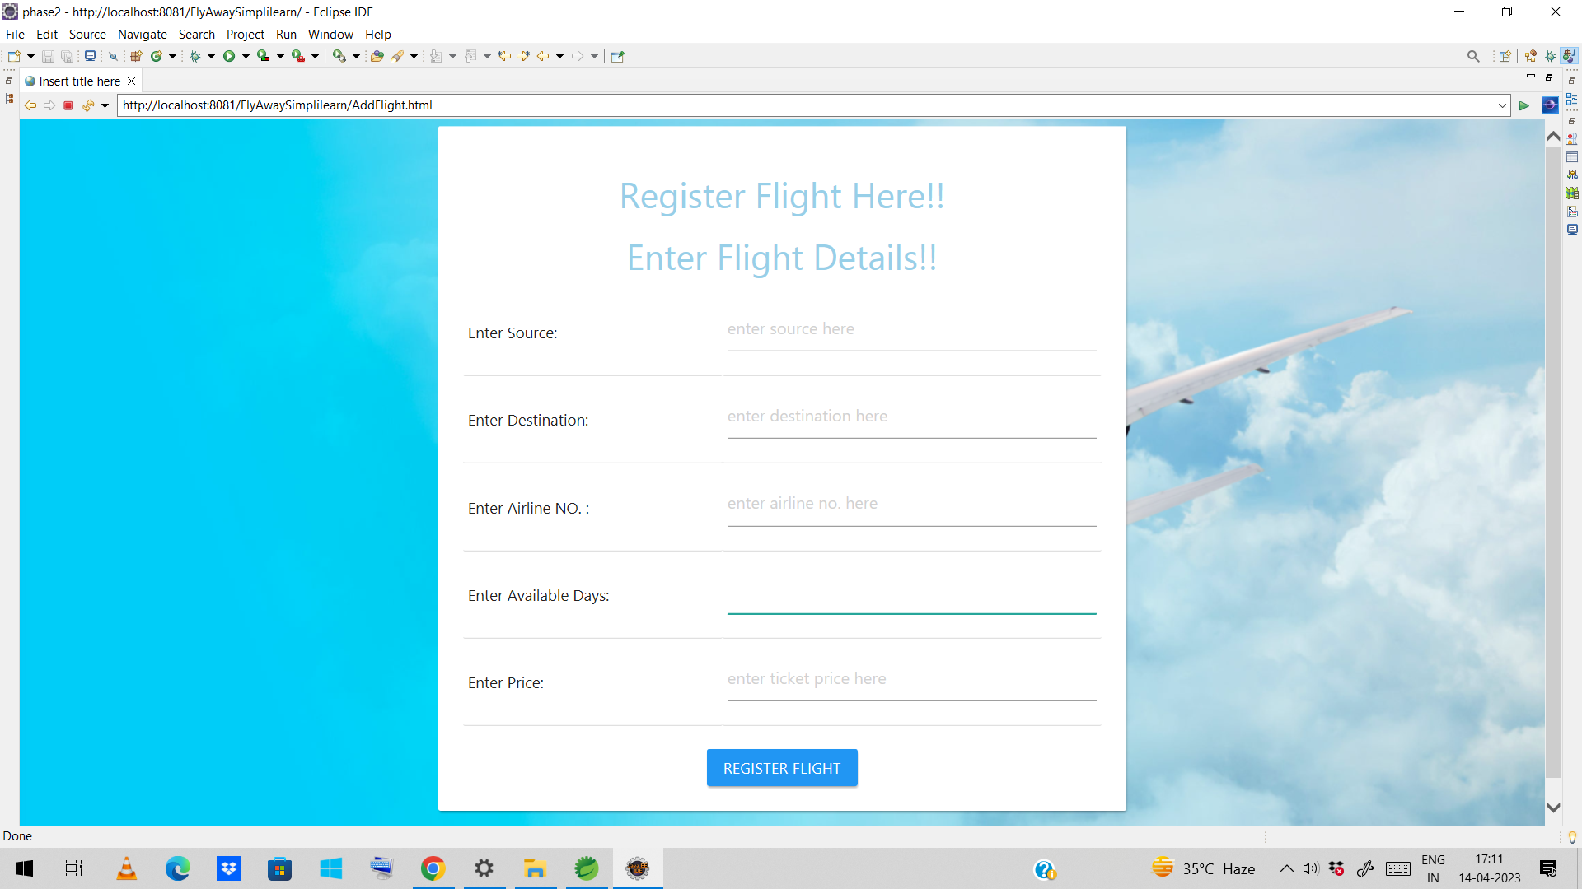
Suppose now admin click on the add flight link to add flight then add flight page will appear on the screen and then admin have to enter flight details to register new flights in the database simplilearn.airline table

Slide 14
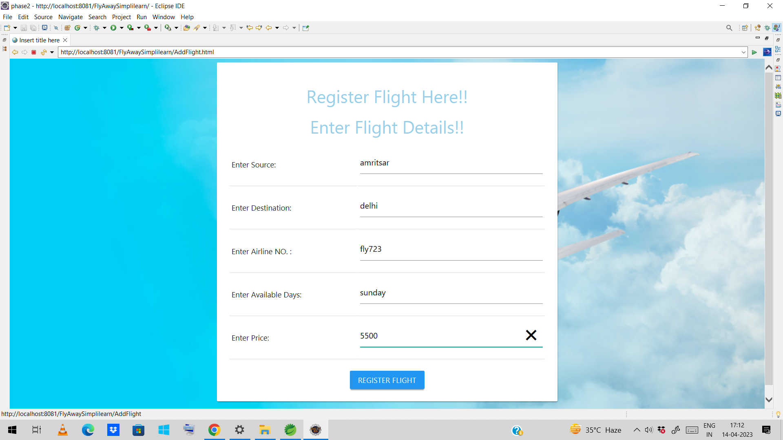
After entering the flights details. As soon as admin clicked on register flight button the flight details will be saved to simplilearn.airline table shown below

Slide 15
Flight added successfully to airline table in the database. And message will appear on the screen Flight added successfully.

Slide 16
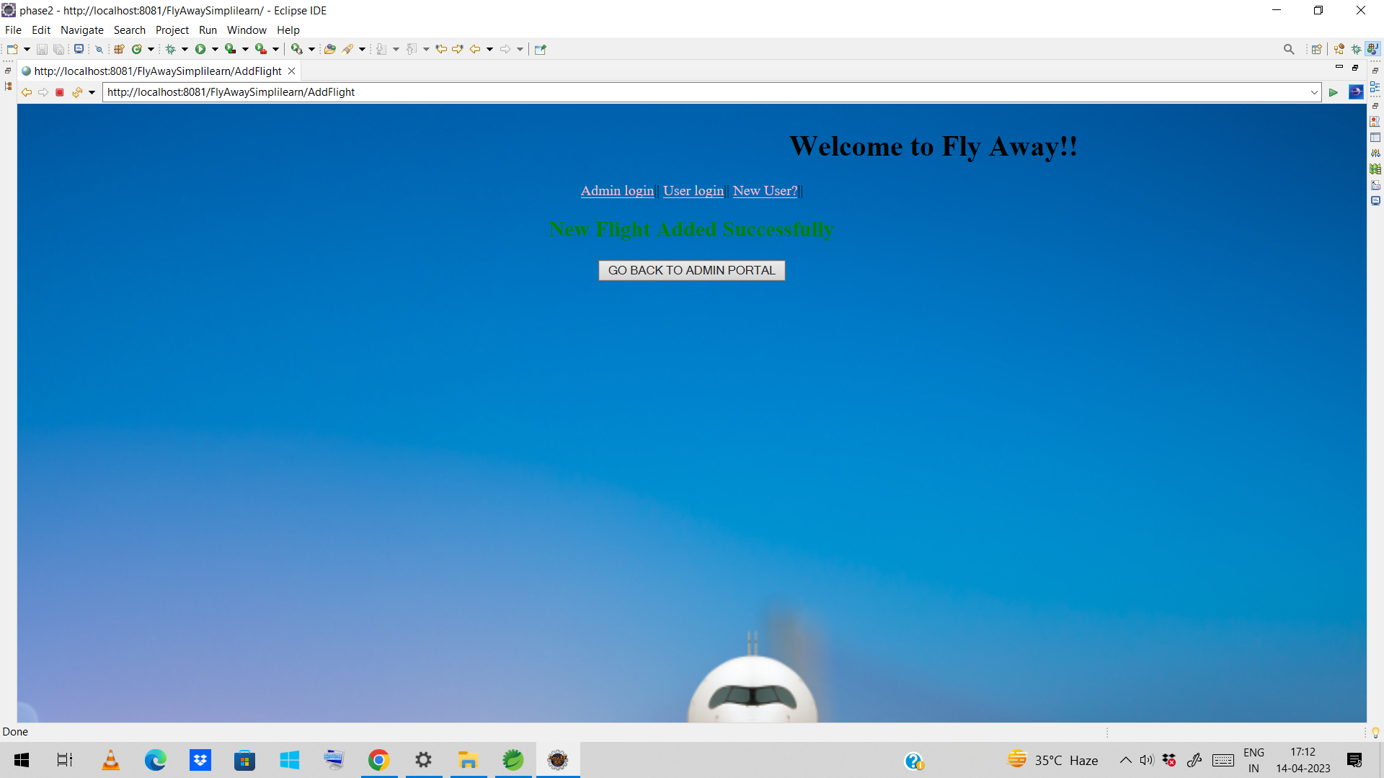
Now click on the button to Go Back To Admin Portal

Slide 17
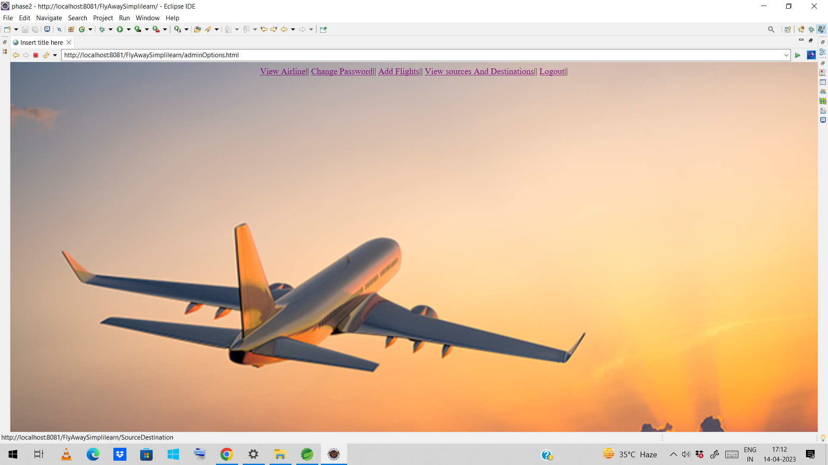
Suppose admin want to see the flight sources and destination this time. So, he clicks on the link View sources and destinations to view sources and destination of the flights fetch from the database in simplilearn,airline table.

Slide 18
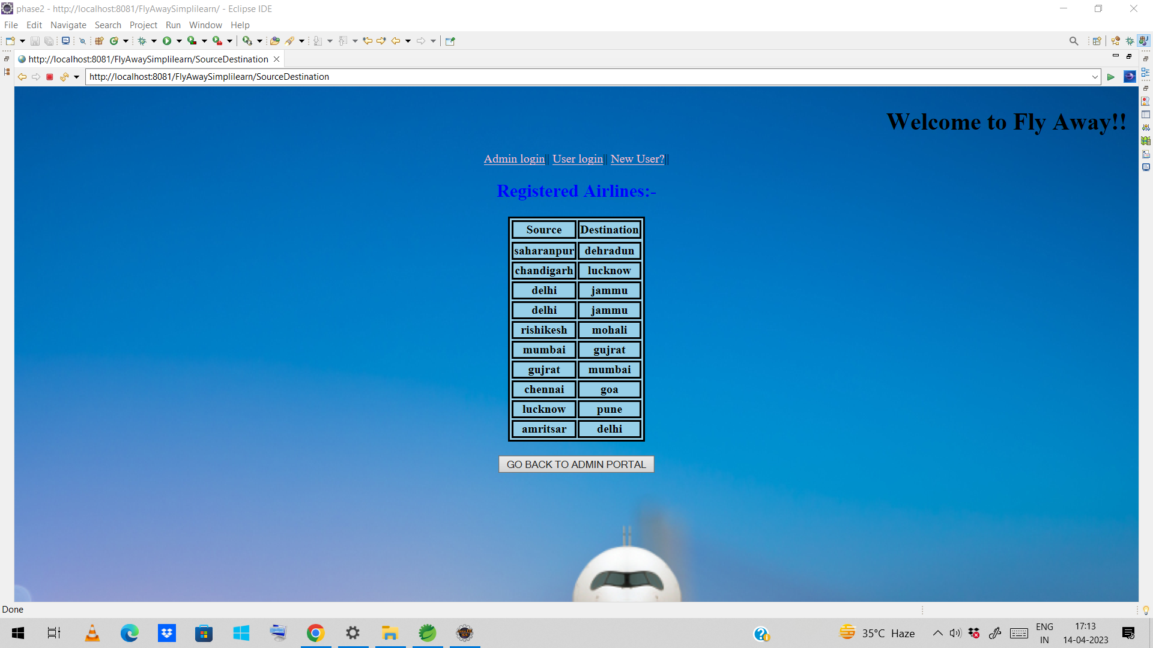
Now click on the button to Go Back To Admin Portal

Slide 19
Suppose this time admin want to logout. So, he clicke on the logout link this time. Then Logout message will be displayed on the screen and admin want to login again to continue.

Slide 20
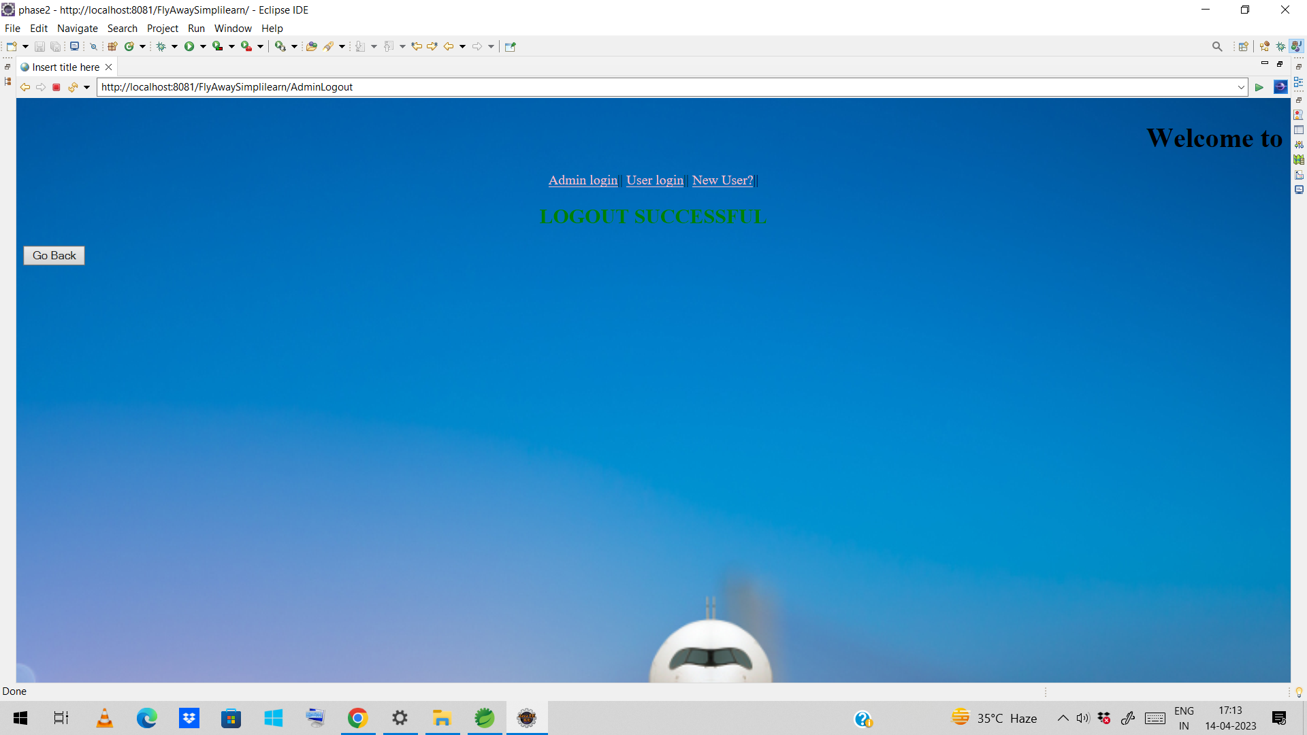
Now user can click on the go back button to continue and he will be redirected to the homepage again

Slide 21
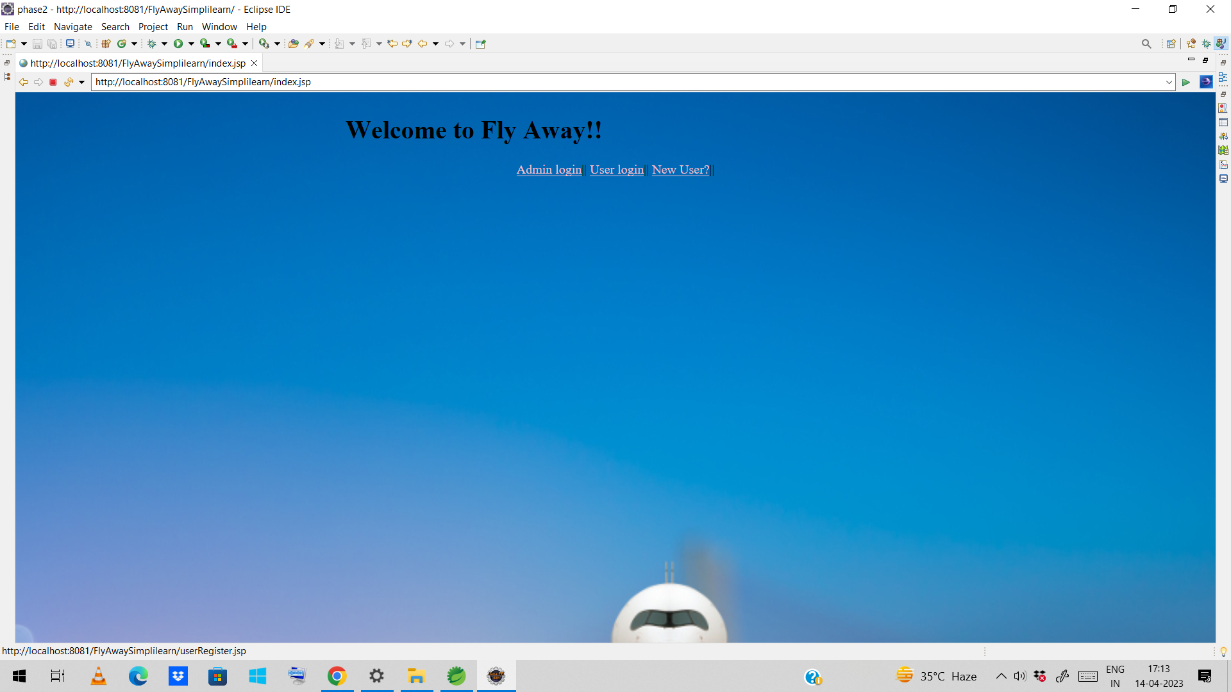
Now, this time user want to register so he click on the new user link. And the new register page will appear on the screen.

Slide 22
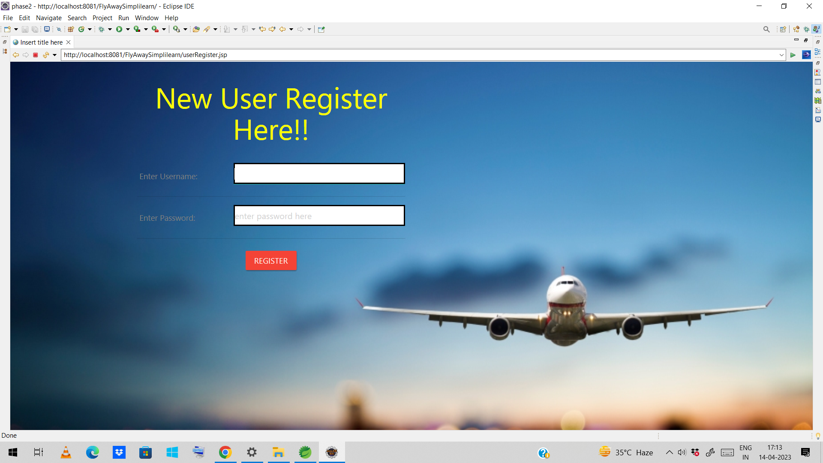
User will enter username and password for registration.

Slide 23

After entering the registering the details the user will be directed to ne page with message you have registered successfully and the user details will be added in the database simplilearn.user

Slide 24
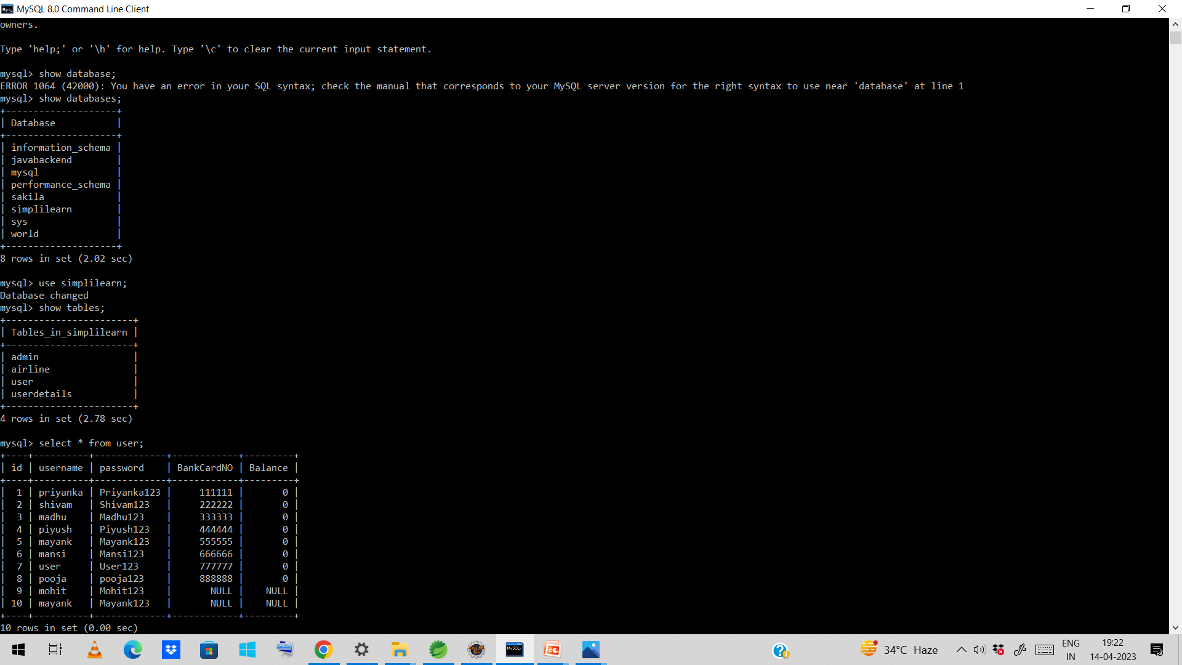
User register detail will be available in user table

Slide 25
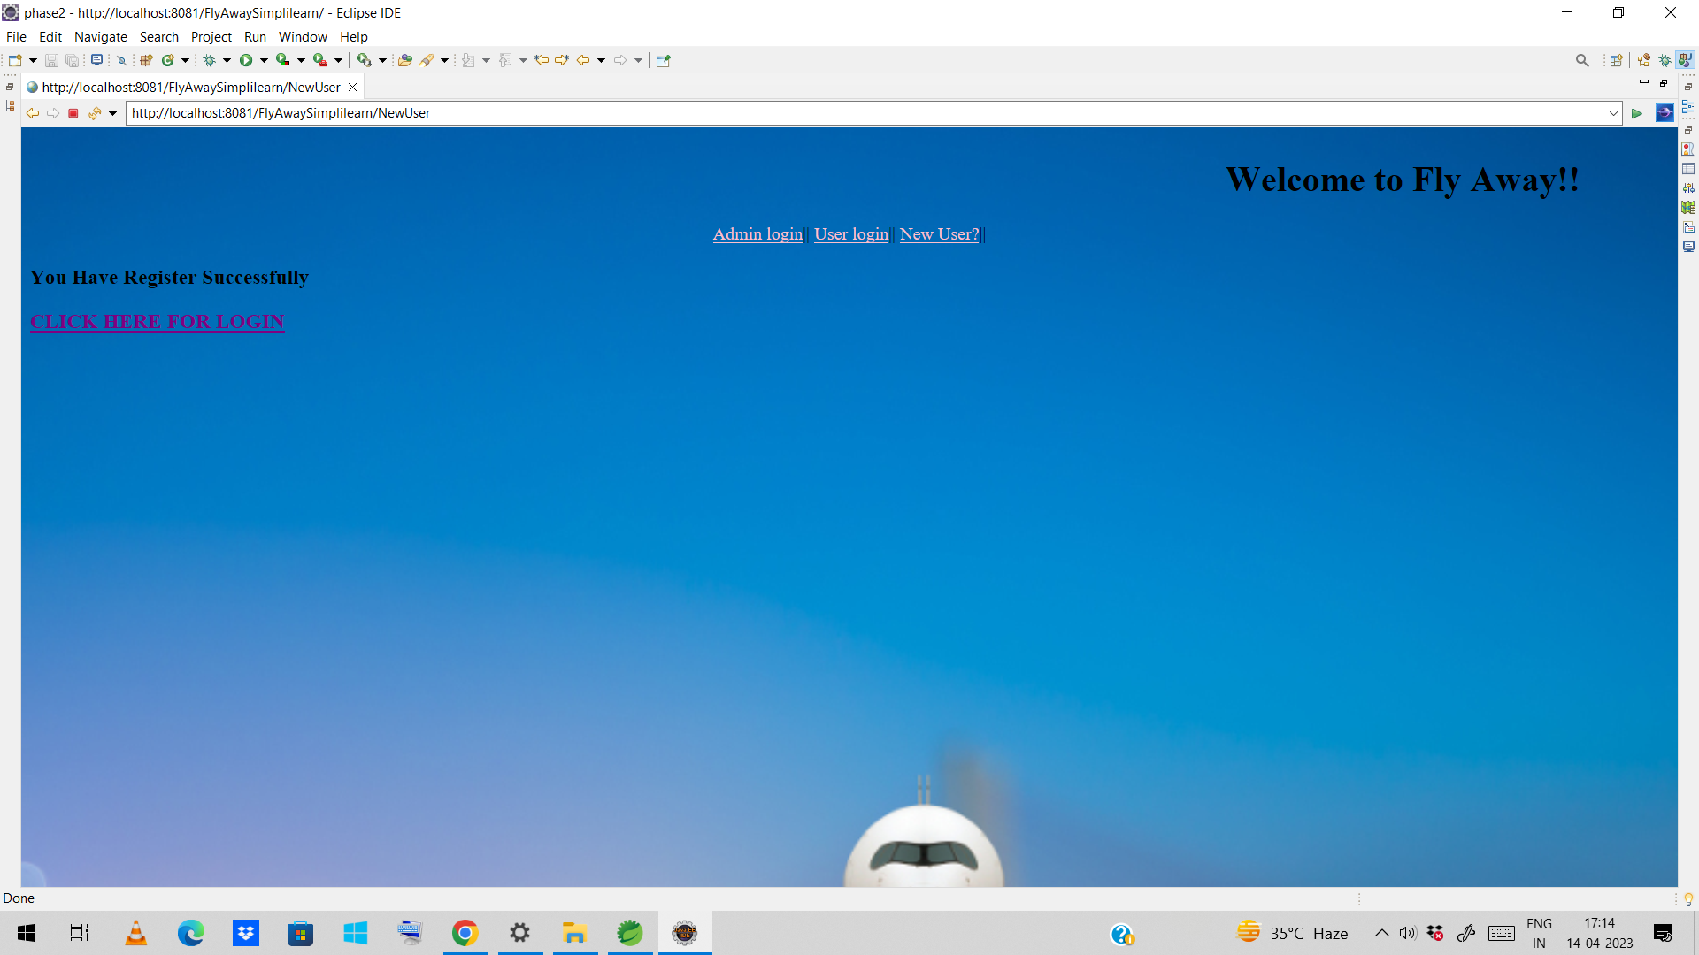
Now user have to click on the link for login.

Slide 26
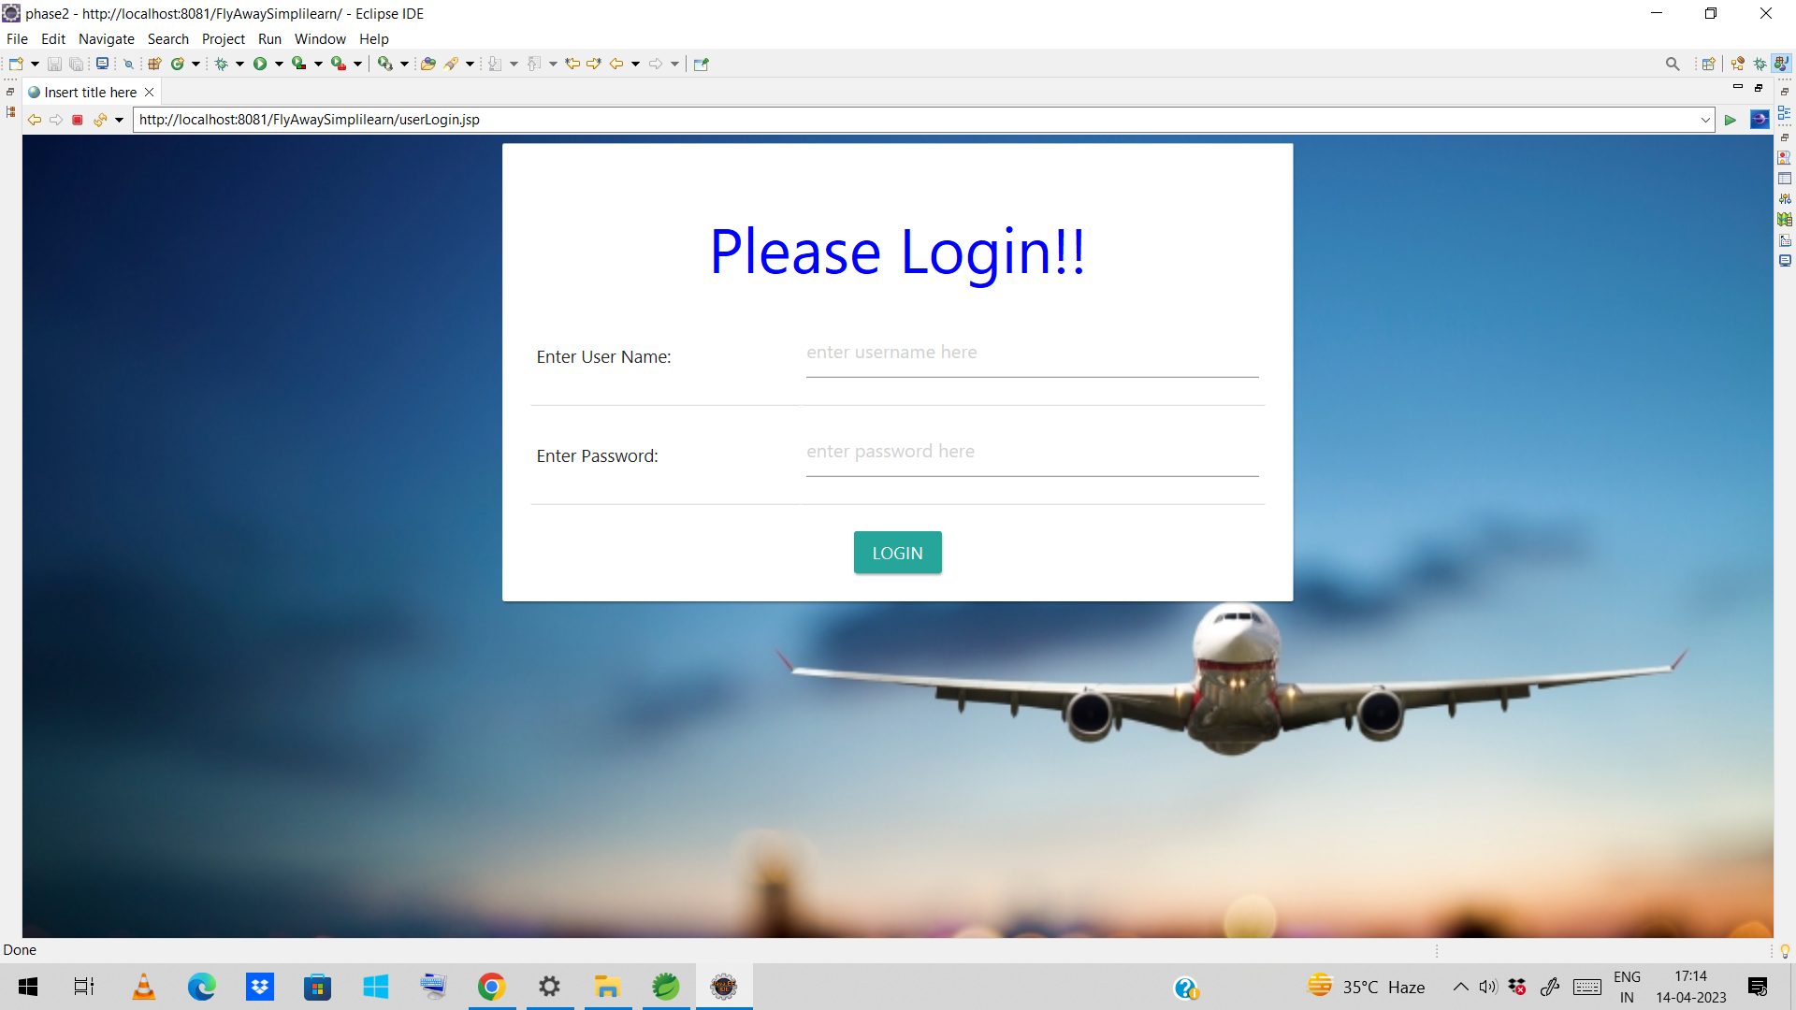
Enter user name and password for login.

Slide 27

After entering the correct details. User will be redirected to the new page where he can enter the flights details.

Slide 28
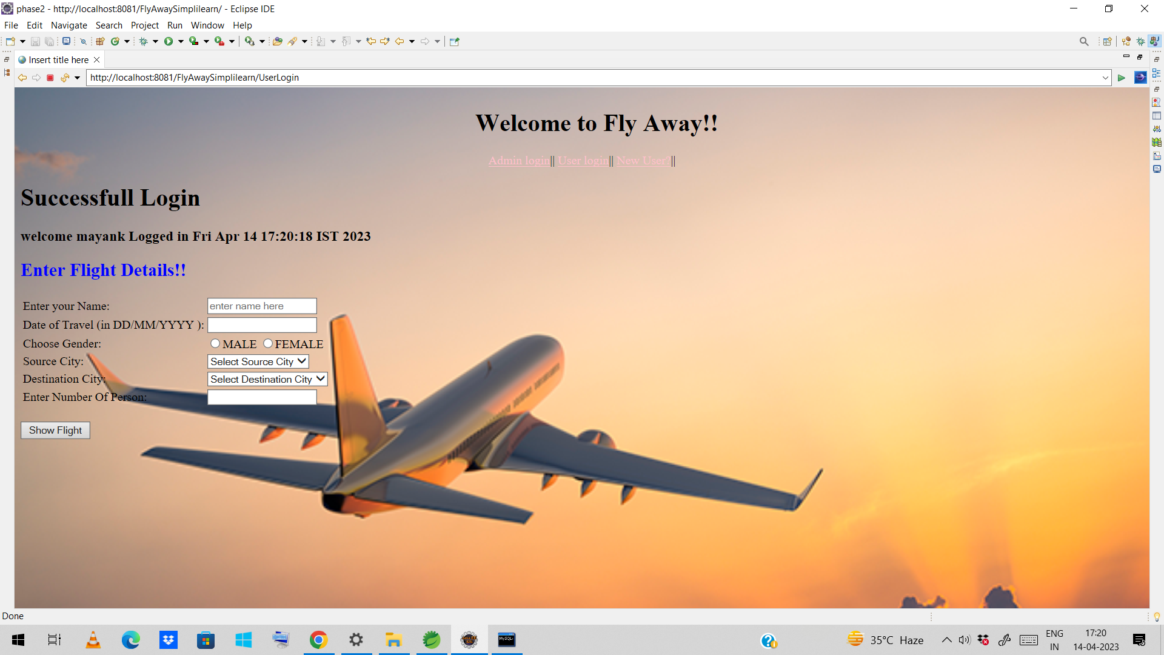
After entering the flights details user can see the flights based on the source and destination if the flight is available between source and destination will be displayed else no flight is available between this source and destination will be displayed

Slide 29
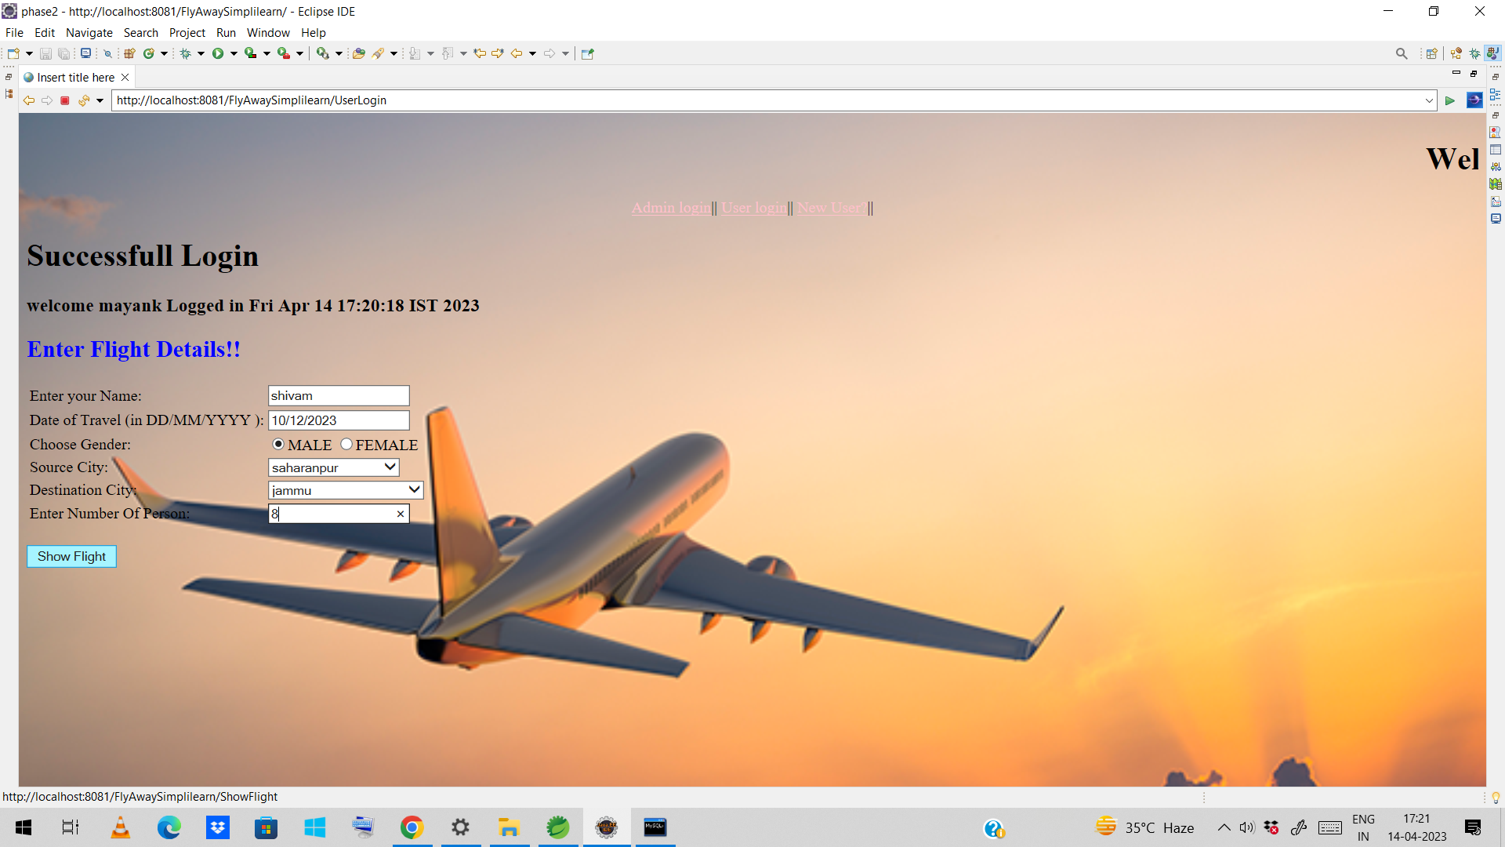

Slide 30
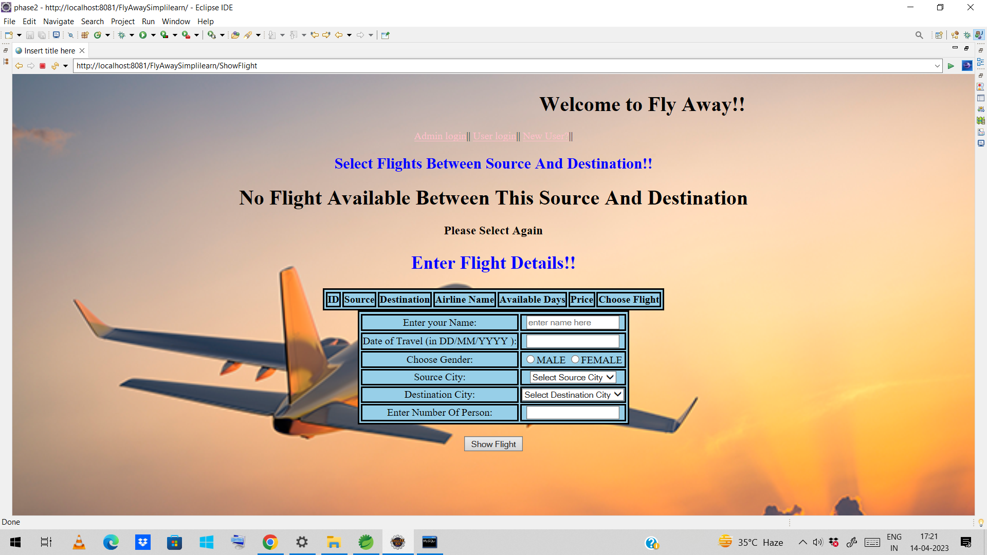
Suppose the user have selected the source and destination where no flight is available between this source and destination. Then the No flight available between this source and destination message will appear on the screen and the user have to enter the flight details again.

Slide 31
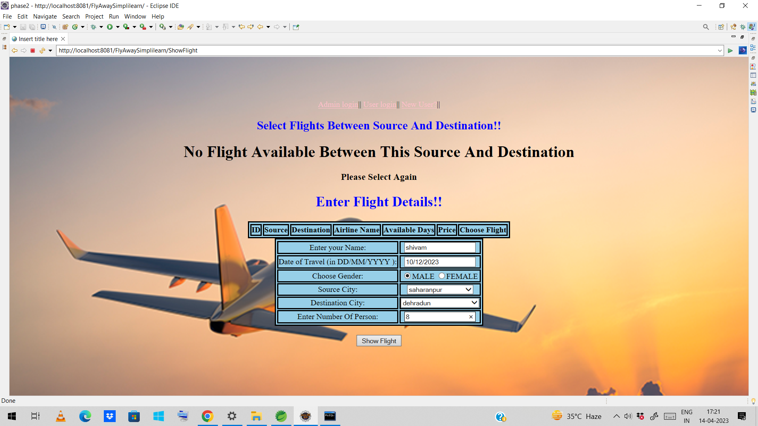
Now, the flight is available between the selected source and destination and new page will open where flight availablity is seen.

Slide 32
Based on this data saved in the database simplilearn.airline table it will show the flights between source and destination only.

Slide 33
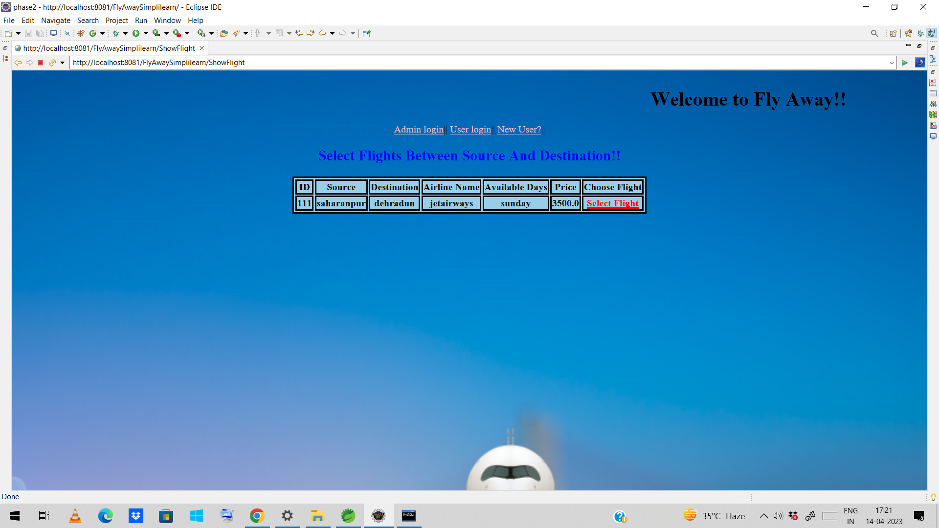
This time user can select the flight he want to book and all the details will be seen in the next page about flight tickets details and price and he can book the flight by entering the payment details and proceed ahead

Slide 34
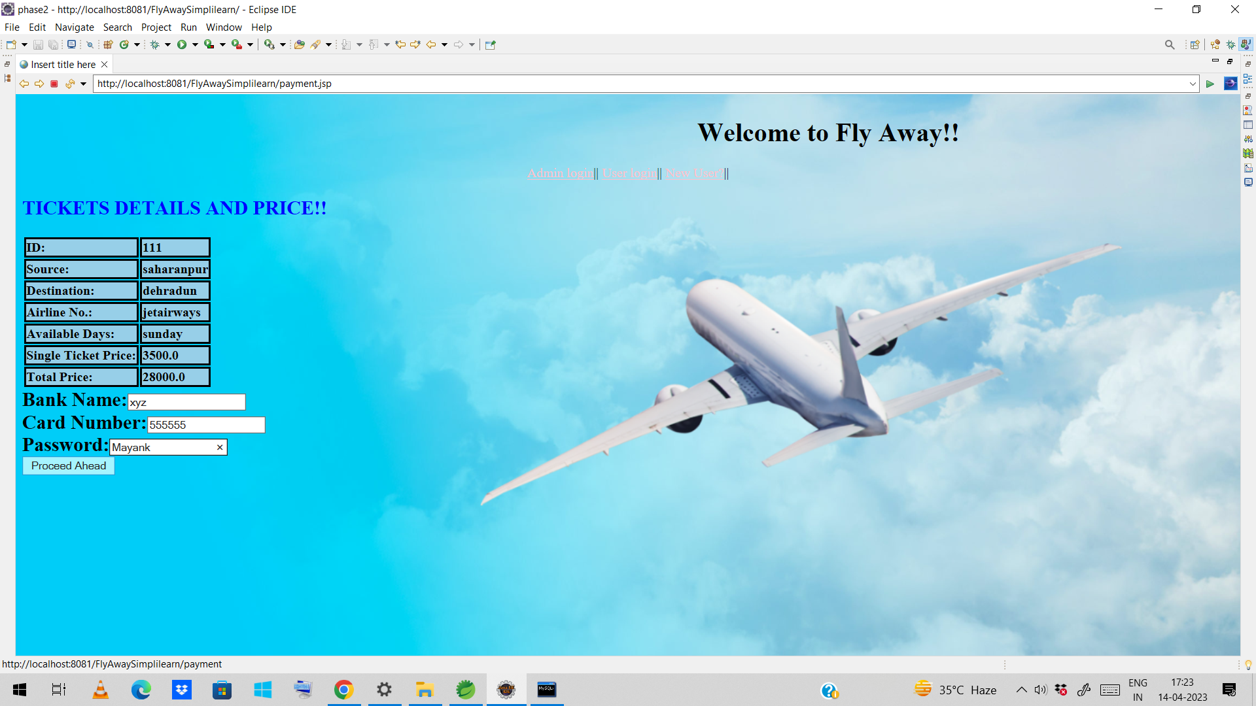
If the user enter the correct card no. and password then the flight will be booked else message will appear card no. or password is incorrect.

Slide 35
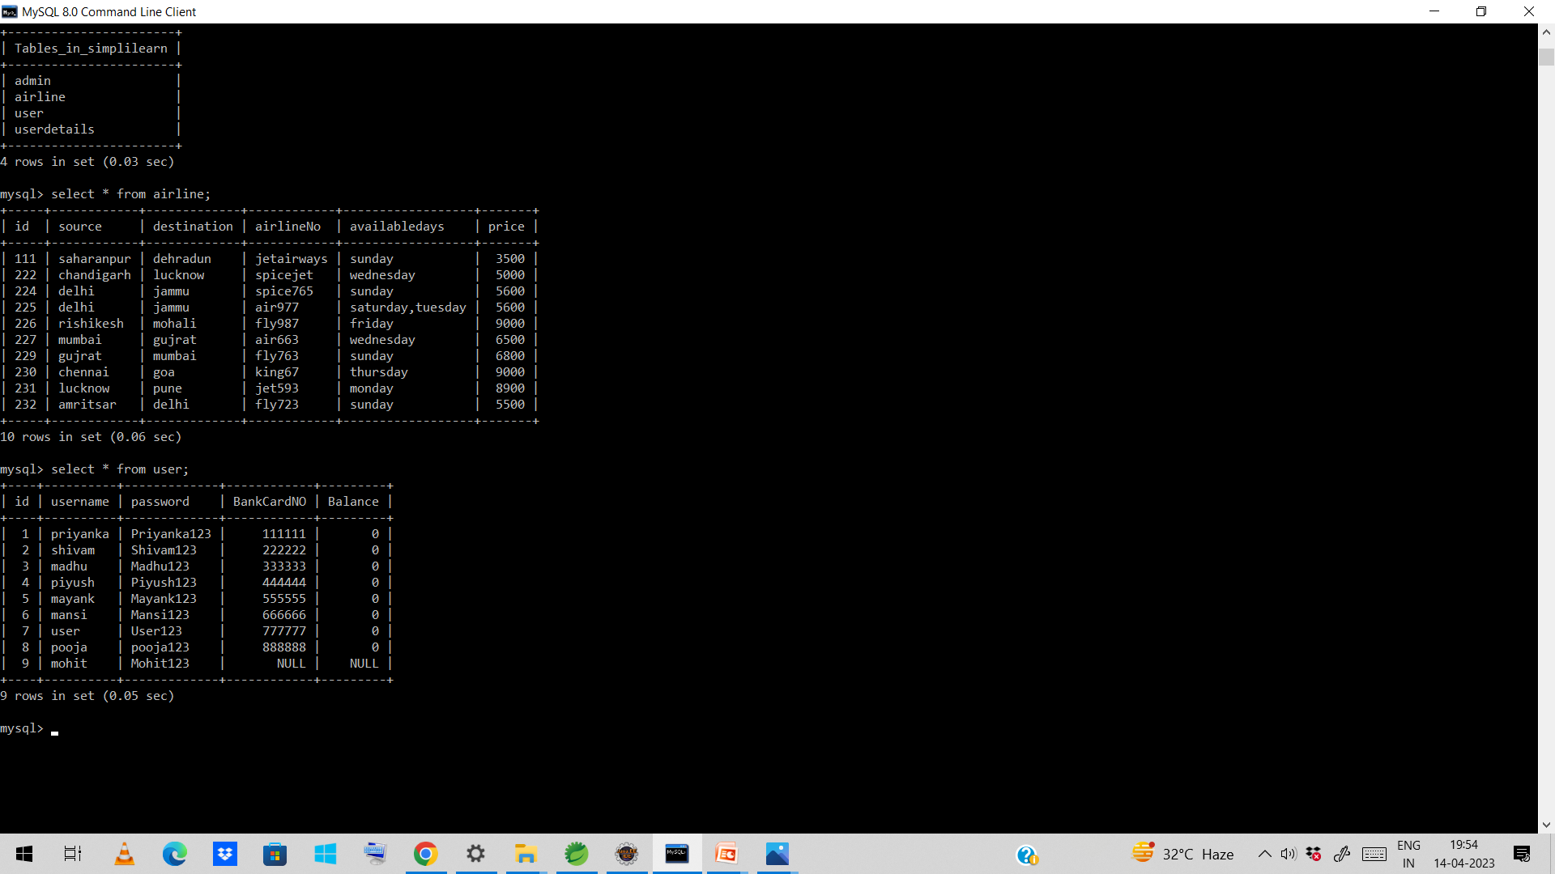
My logic is to just check the card no. and password entered by the user matches with the database simplilearn.user then the message will displayed ticket booked successfully else card no. and password is incorrect. User can enter random bank name.

Slide 36
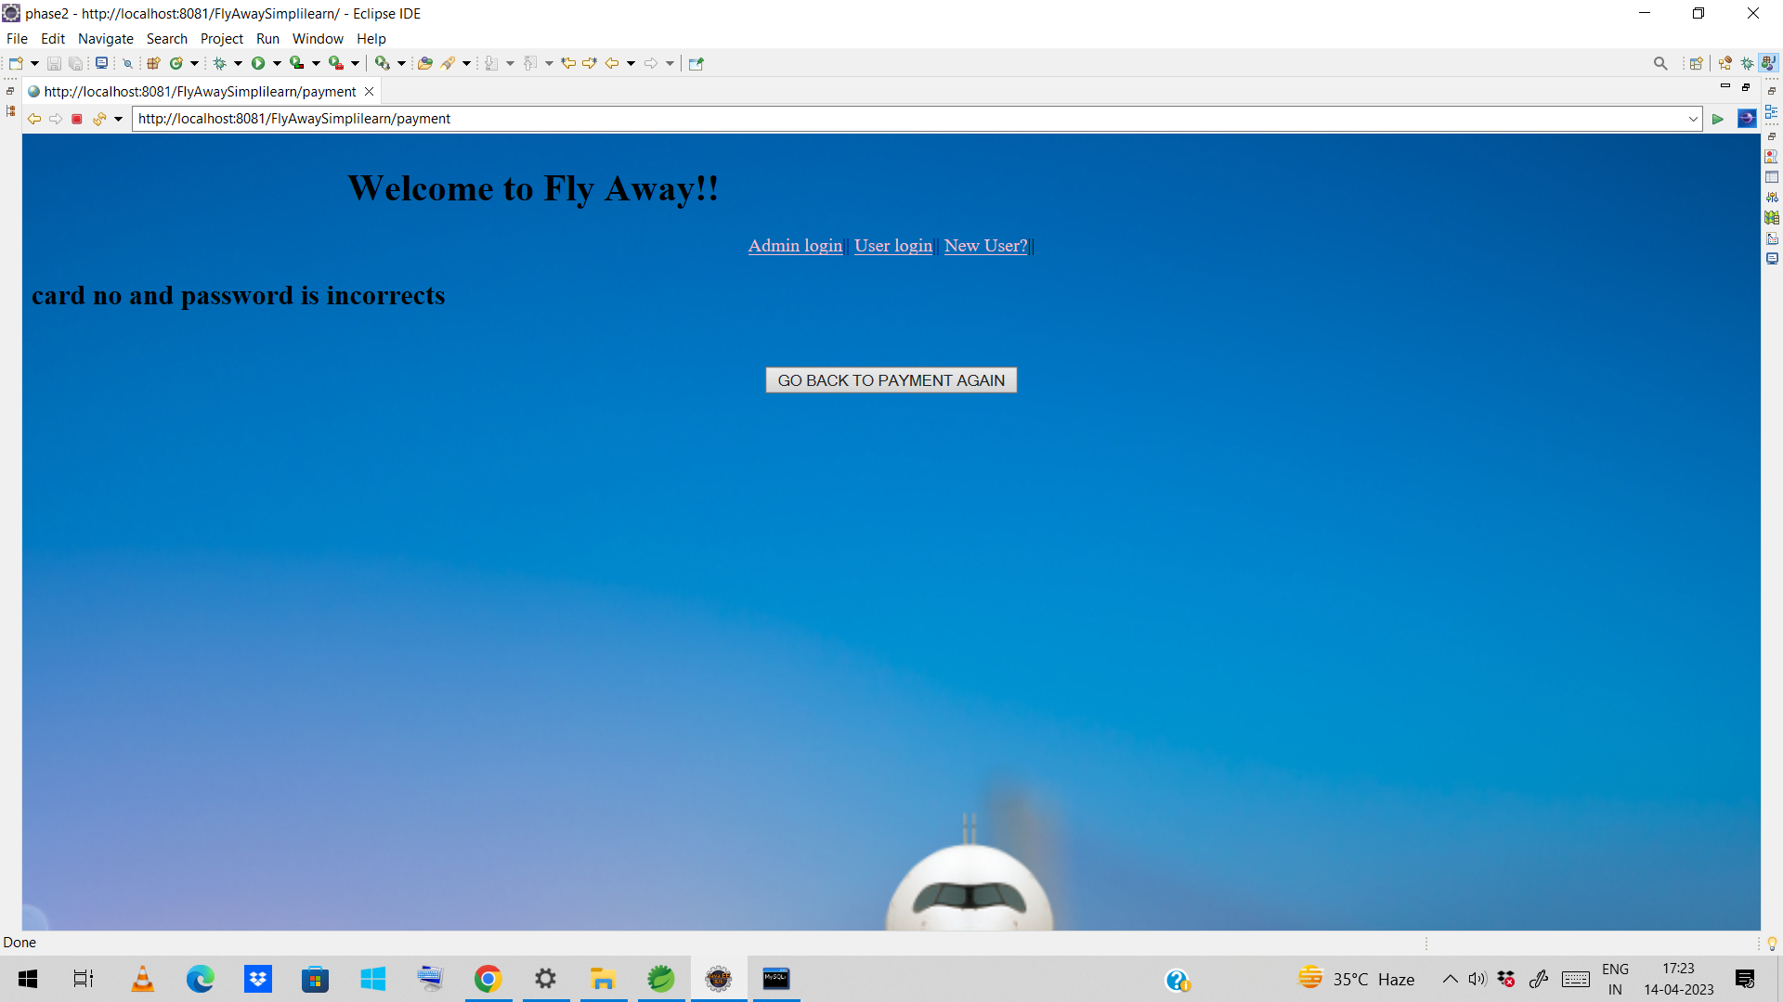
Here the entered bank card and user password does not match with the database that’s why the message is printed card no. and password is incorrect.user can click on the go back to button to make payment again.

Slide 37
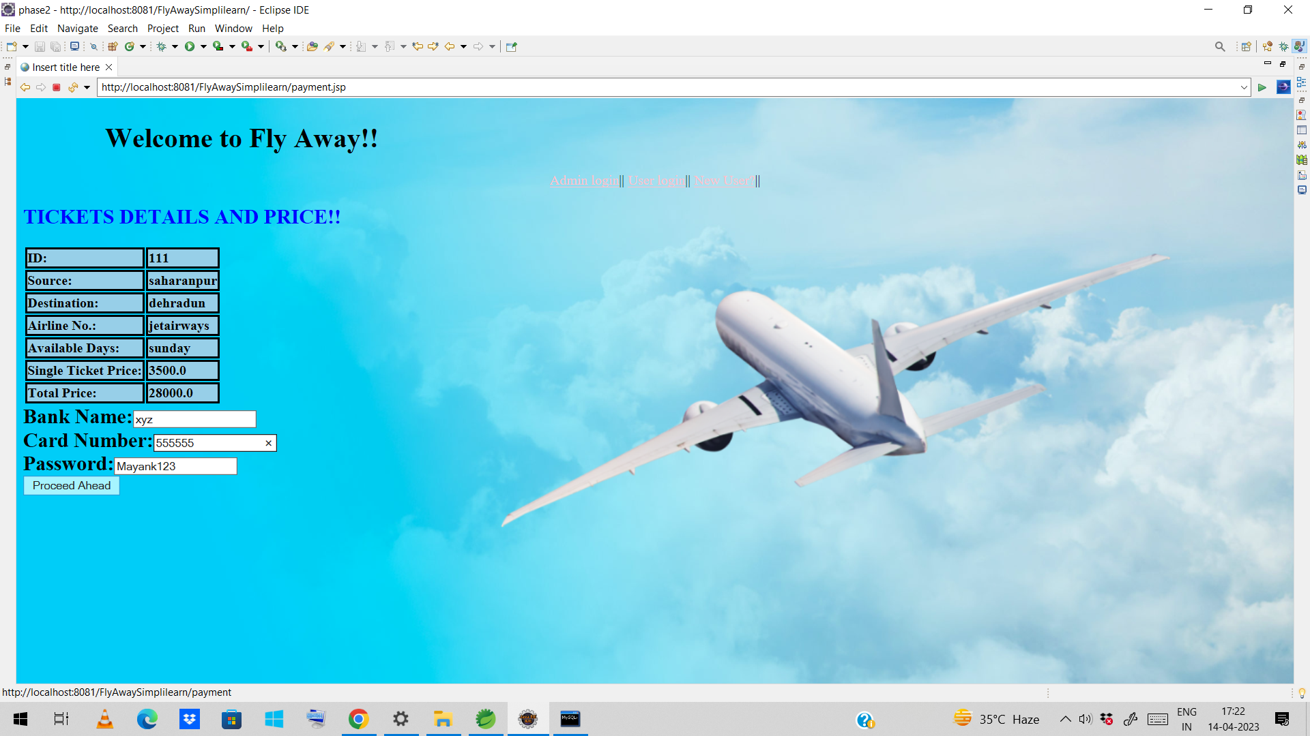
This time time user enter the correct bank card no. and password. Then he will be redirected to new page with message ticket booked successfully. NOTE- Make sure user can enter any value in bank name as I m not checking bank name value from the database

Slide 38
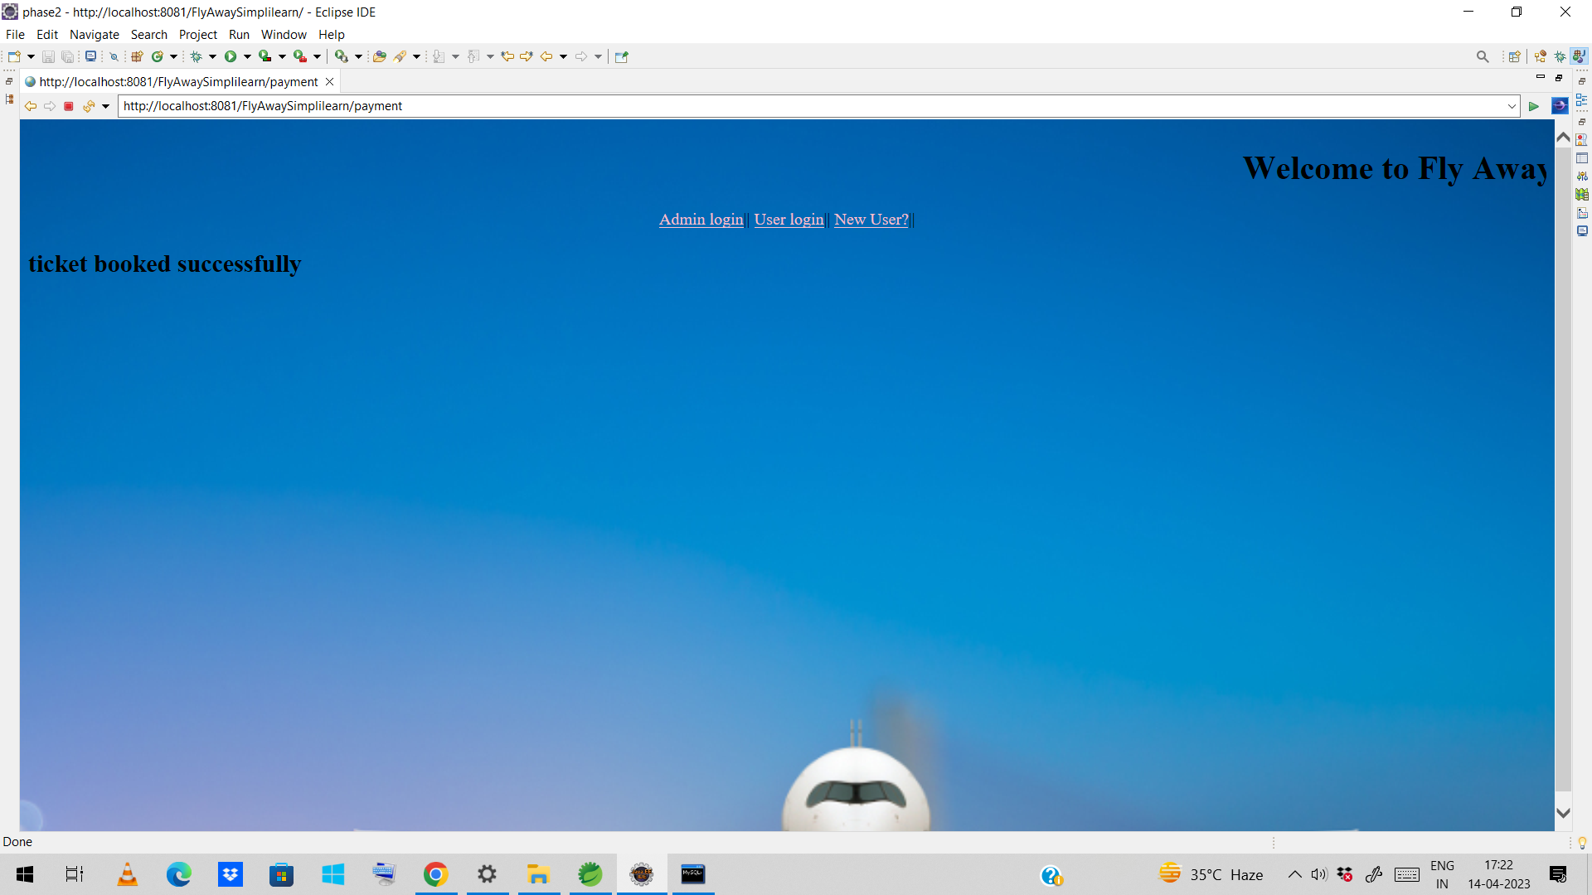
After entering bank card no. and password correctly. Message will diplayed on the screen ticket booked successfully. And user can still continues by clicking on the link mention above

